Slide 1
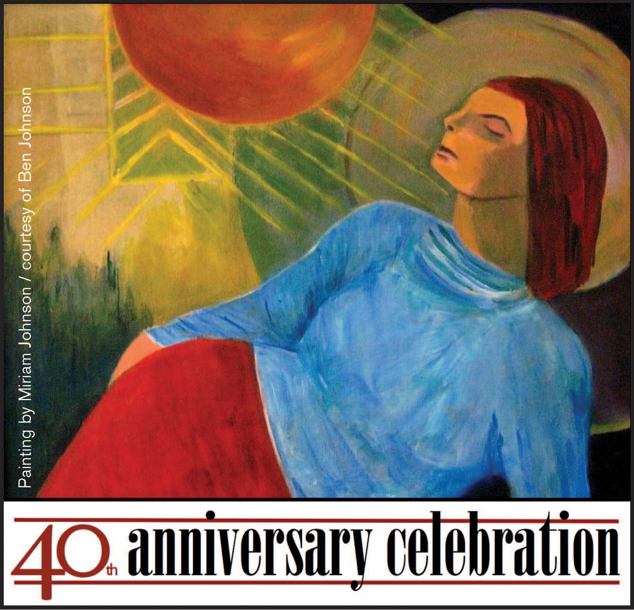
November 7 − 9, 2013
Erb Memorial Union
University of Oregon
Presented by the Center for the Study of Women in Society, ASUO Women’s Center, and the Department of Women’s and Gender Studies
A celebration of feminist research, teaching, and activism on campus
Register at
csws.uoregon.edu

Slide 2
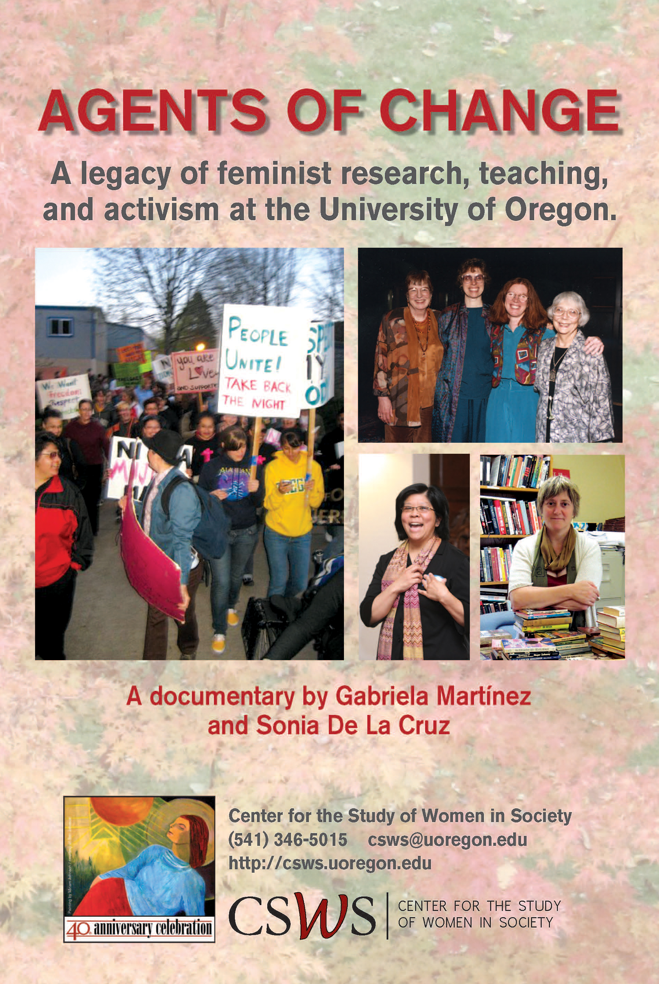
Thursday, November 7
3 − 6:30 p.m. EMU Gumwood Room
Special guest speakers including
Eugene Mayor Kitty Piercy
40th Anniversary Celebration
Center for the Study of Women in Society, ASUO Women’s Center, and Department of Women’s and Gender Studies
Film Premiere:
Agents of Change
Add Image Here
Register at
csws.uoregon.edu

Slide 3
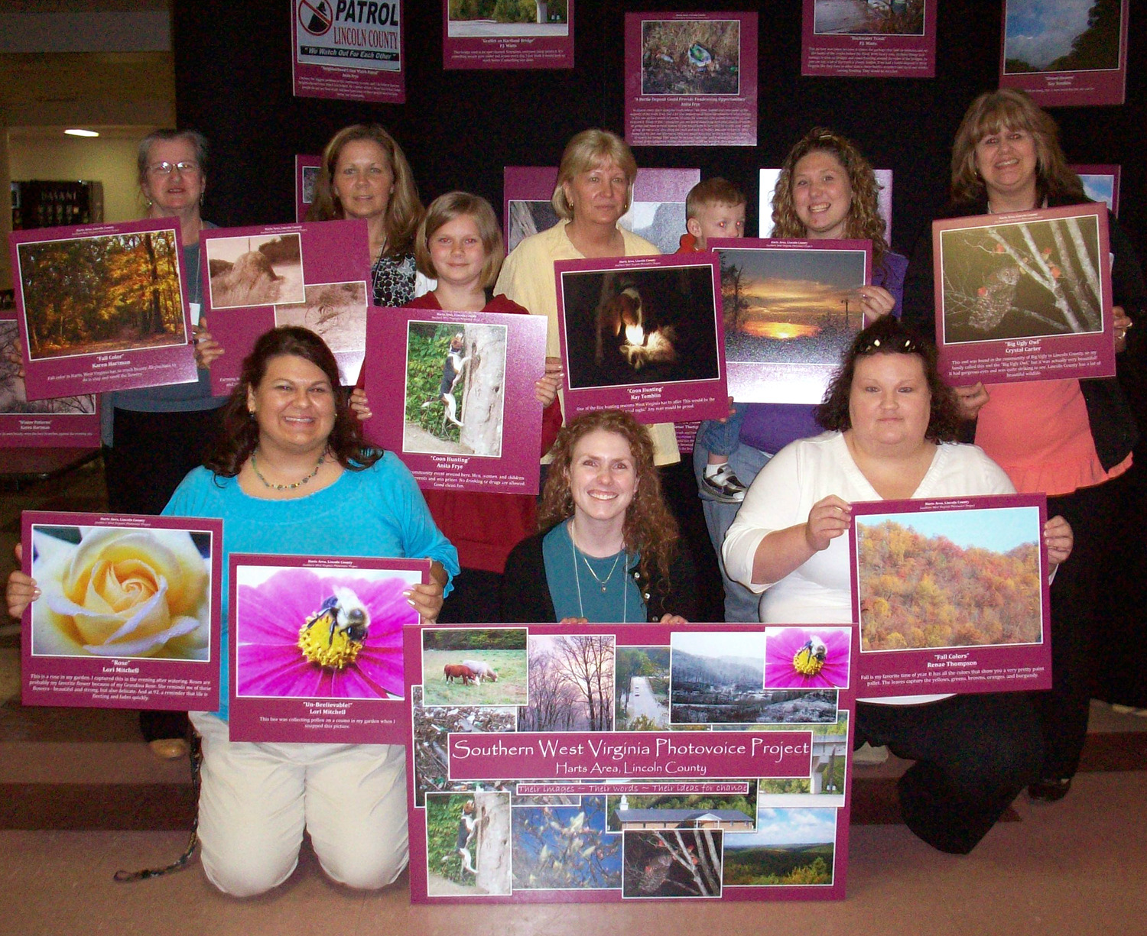
Friday, November 8
9 a.m. − 5 p.m. EMU Ballroom
Sharing narratives from forty years of feminist research, teaching, and activism
“Women’s Stories, Women’s Lives” Symposium
Add Image Here
40th Anniversary Celebration
Center for the Study of Women in Society, ASUO Women’s Center, and Department of Women’s and Gender Studies
University of Kentucky professor and UO graduate Shannon Elizabeth Bell, front center, with Harts Photovoice Group at their 2009 exhibit in West Virginia. Bell will be speaking about women and grass-roots environmental justice at the “Women’s Stories, Women’s Lives” Symposium on November 8.
Register at
csws.uoregon.edu

Slide 4
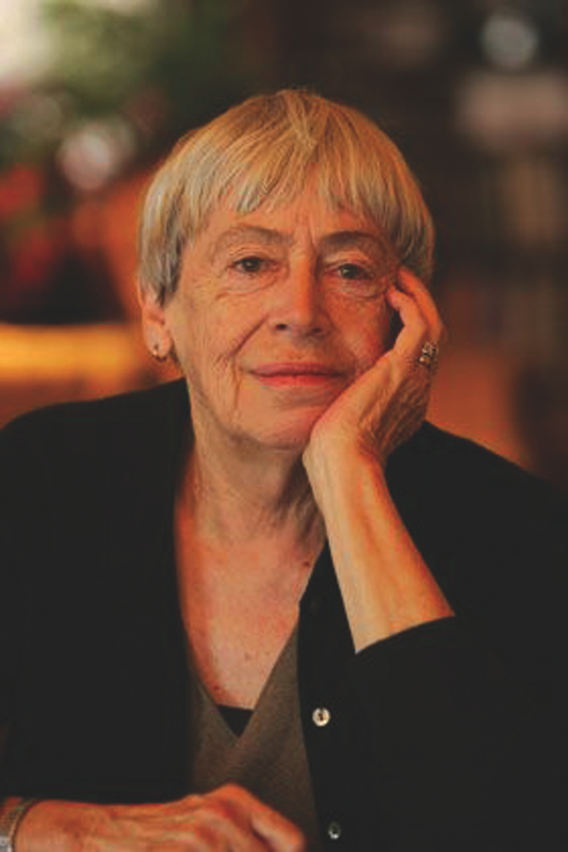
Friday, November 8
6:30 p.m. − 9 p.m.
EMU Ballroom
40th Anniversary Celebration Keynote Event:
“A Conversation with
Ursula K. Le Guin”
Ursula K. Le Guin / Photo by Dan Tuffs
Register at
csws.uoregon.edu

Slide 5
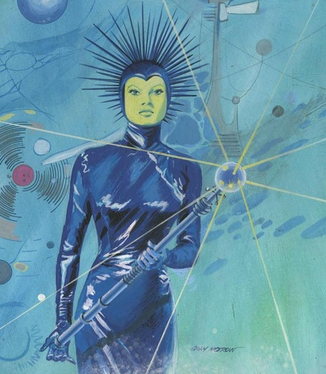
Saturday, November 9
9 a.m. − 6 p.m. EMU Ballroom
An exploration of science fiction and utopian ideas in imagining feminist futures
40th Anniversary Celebration event with award-winning authors Suzy McKee Charnas, L. Timmel Duchamp, Molly Gloss, Andrea Hairston, Vonda N. McIntyre, and Kate Wilhelm
Feminist Science Fiction Symposium
Sally Miller Gearhart
“Worlds Beyond World”
Register at
csws.uoregon.edu

